Slide 1
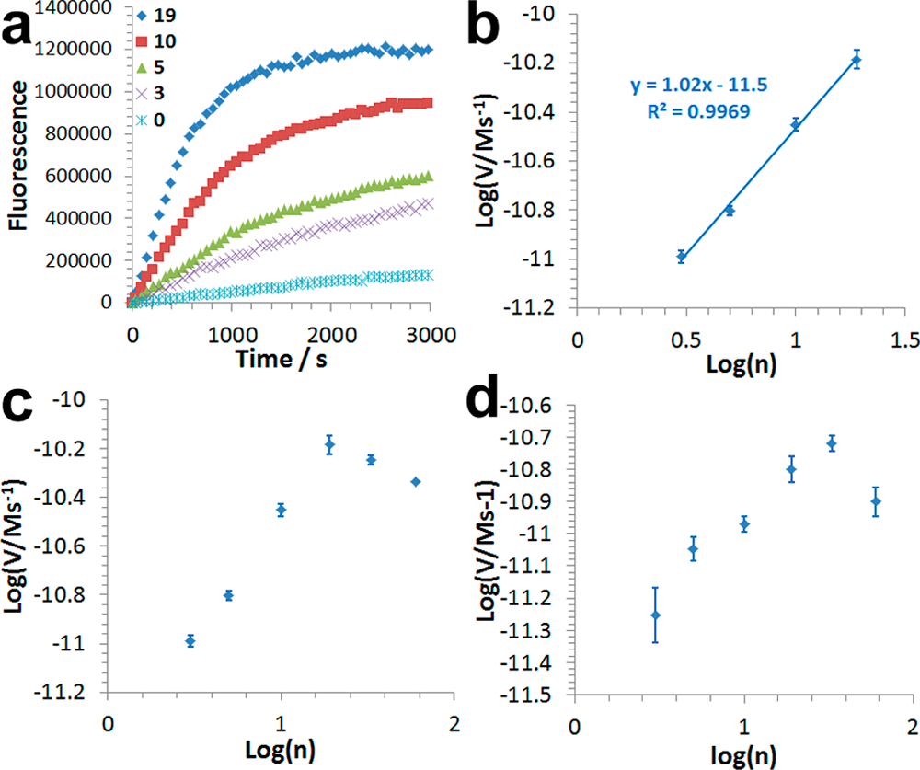
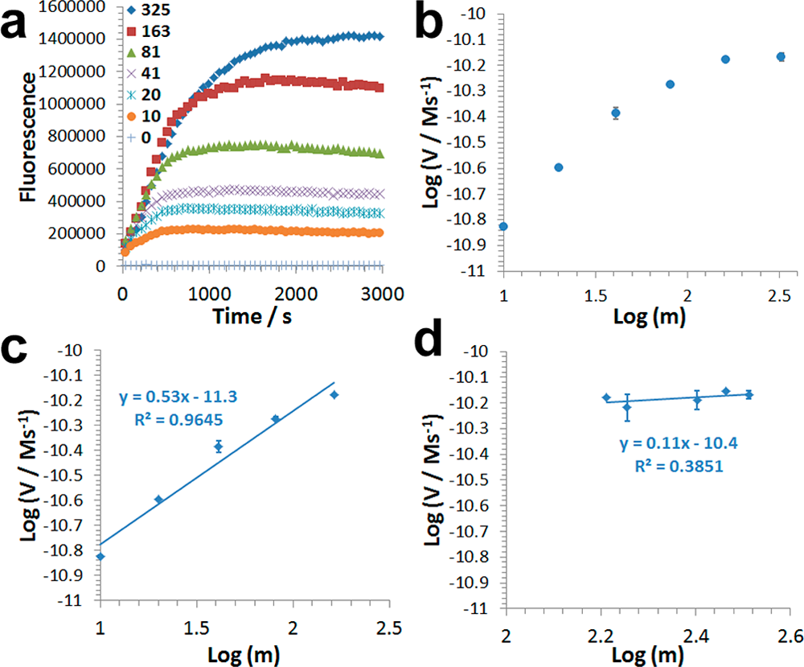
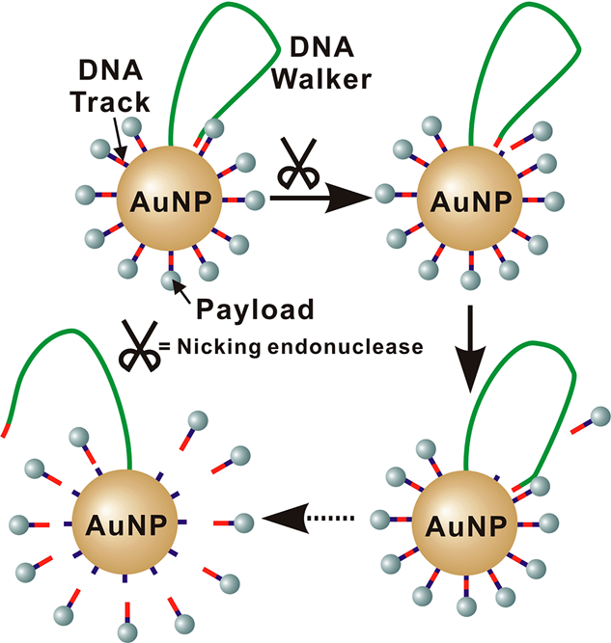
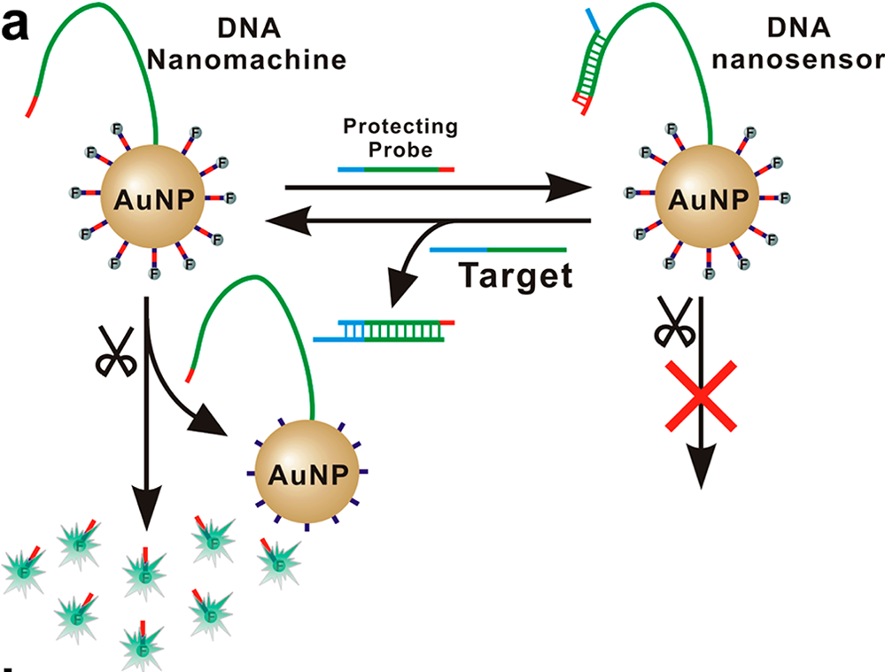
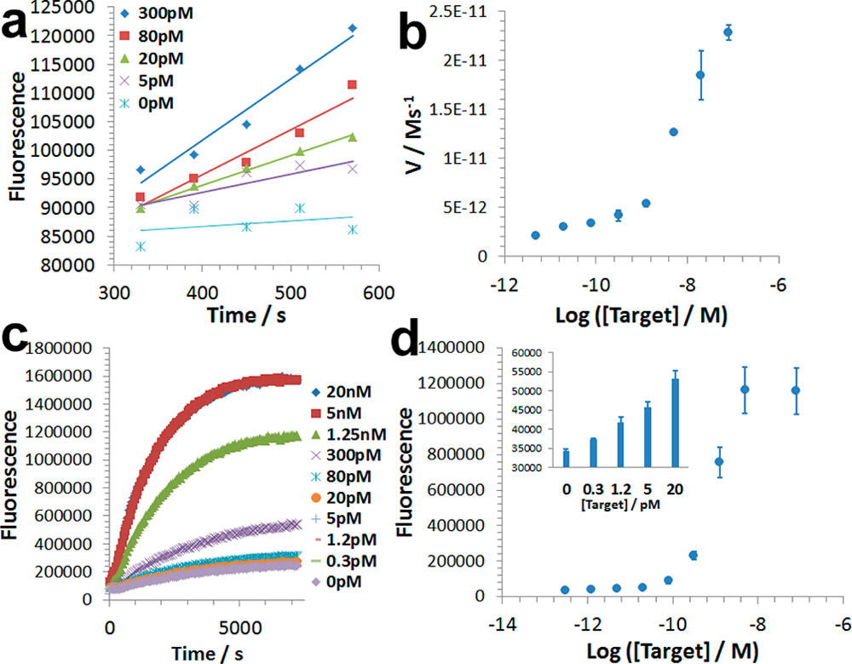
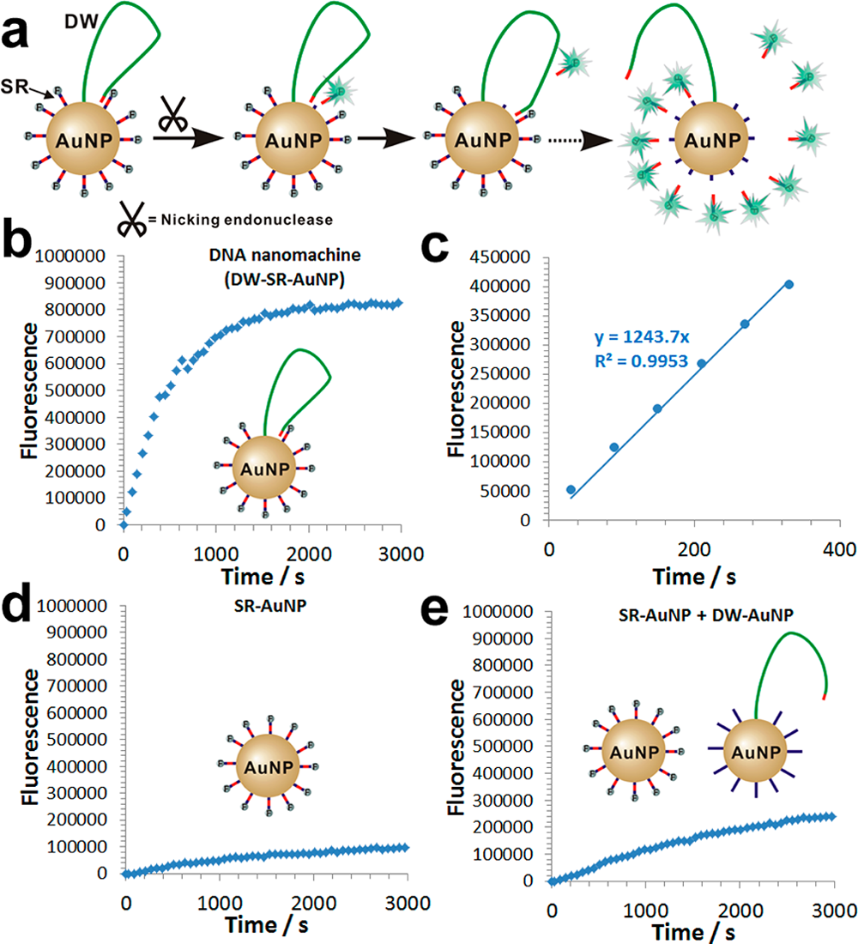
Enzyme-Powered Three-Dimensional DNANanomachine for DNA Walking, Payload Release, and Biosensing
Xiaolong Yang, † Yanan Tang, † Sean D. Mason, † Junbo Chen, ‡ and Feng Li†
† Department of Chemistry, Centre for Biotechnology, Brock University, St. Catharines, Ontario, Canada L2S3A1
‡ Analytical & Testing Center, Sichuan University, Chengdu, Sichuan 610064, China
Introduction
Kinetic Study of the 3-D DNA Nanomachine toward Efficient Payload Release
Currently, almost all DNA walking devices make use of one-dimensional (1-D) DNA footpaths or two-dimensional (2-D) DNA origami as tracks to guide the movement of DNA walkers.
One of the most frequently used energy inputs for DNA walking devices is through the cleavage of DNA substrates along the tracks by endonucleases, deoxyribozymes or photoirradiation.
Studied parameters:
- densities of DW(n)
- densities of SR (m)
- length of DW (l)
- concentration of ([AuNP])
- concentration of enzyme ([E]).
Aim of the work
They designed a novel DNA nanomachine that is able to confine the movement of a DNA walker on a 3-D track built from DNA-functionalized gold nanoparticles (DNA−AuNPs) for rapid payload releasing and biosensing.
-The 3-D track is a densely functionalizing a
20 nm gold nanoparticle (AuNP) with DNA
substrates (DSs).
-Single-foot DNA walkers (Dws) are tethered to the same DNA−AuNP.
-The DW have a 7 nt nicking recognition
sequence, and the DS have a 7 nt
complementary nicking cleavage sequence.
-In the presence of the nicking endonuclease, the DW is able to walk along the 3-D track by cleaving one DS at each step.
V = K′·[DW] (n ≤ n crit ).
Given the linear equation it is possible to quantify DW as a “target” in a solution by measuring the initial rate of the nanomachine.
Engineering the 3-D DNA Nanomachine into a DNA Nanosensor
Methodology
Protecting DNA probe P deactivate the
nanomachine by hybridizing DW:
- complementary DW (green and red)
- block niking site (red)
- DNA toehold(blue)
Preparation and Characterization of the 3-D DNA Nano-machine
In a typical experiment, the thiolated DW and SR oligonucleotides at a ratio of 1 to 20.
A 20 μL solution mixed with 1 mL of 1 nM AuNPs. This mixture was incubated than mixed with 20 μL of 3 M NaCl, followed by 10 s of sonication. The solution was centrifuged at 13 500 rpm for 30 min to separate the DNA-functionalized AuNPs (DNA−AuNPs) from the unreacted reagents.
After preparation, UV−vis spectrometry was used to characterize the quality of each DNA−AuNP solution.
Preparation and Characterization of the DNA Nanosensor
The procedure is the same as that for the DNA nanomachine, except that 2.5 μM DW was first hybridized with equal amounts of the protecting DNA P through an annealing process.
Nucleic Acid Analysis Using the DNA Nanosensor
Detection of a MTB DNA Target Using the DNA Nanosensor
Quantification of DNA targets using DNA nanosensors.
(a) initial rate with different target concentration.
(b) Initial rate as a function of target concentration.
(c) Real-time in a period of 2 h.
(d) Quantification of targets at 1 h.
Mixtures containing 100 pM DNA nanosensors and varying concentrations of target DNA were incubated at 37 °C for 10 min.
To each mixture was added 20 U nicking endonuclease.
Immediately after the enzyme was added, fluorescence signals were measured every 1 min with an excitation/emission wavelength of 485/535 nm.
Results
Construction and Characterization of the 3-D DNA Nanomachine
Conclusion
As a proof-of-principle they attached a fluorescent dye(FAM), as a
payload to the DS.
B - 100 pM DW−SR−AuNP.
C - initial rate of DW−SR−AuNP
D - 100pM SR−AuNP control
E - cross-reaction control:
100 pM SR−AuNP
100 pM DW−AuNP
The results suggest that movement of the DW has been well-defined
by the 3-D DNA−AuNP track on each nanomachine.
The increases in local effective concentrations of DNA probes accelerate enzymatic cleavage, making the 3-D DNA nanomachine amenable for the task of rapid payload
Release.
The concept of integrating multiple functional components on a single nanoparticle opens up new concepts and strategies in dynamic DNA nanotechnology, which may lead to the development of novel DNA nanodevices, drug delivery vehicles, and biosensors.
References
-Pan, J.; Li, F.; Cha, T.-G.; Chen, H.; Choi, J. H. Recent Progress
on DNA Based Walkers. Curr. Opin. Biotechnol. 2015, 34, 56−64.
-Tang, Y.; Wang, Z.; Yang, X.; Chen, J.; Liu, L.; Zhao, W.; Le, X.
C.; Li, F. Constructing Real-Time, Wash-Free, and Reiterative Sensors
for Cell Surface Proteins Using Binding-Induced Dynamic DNA
Assembly. Chem. Sci. 2015, 6, 5729−5733.

